Slide 1
LED Mindgame
Von: Alexander Quindt, Yven Klein und Flaviu Nicolau

Slide 2
Inhaltsverzeichnis
Spielregeln
Planung
Box
Code
Live-Presentation
Probleme

Slide 3
Spielregeln
Reihenfolge LED
Merken
Wiederholen

Slide 4
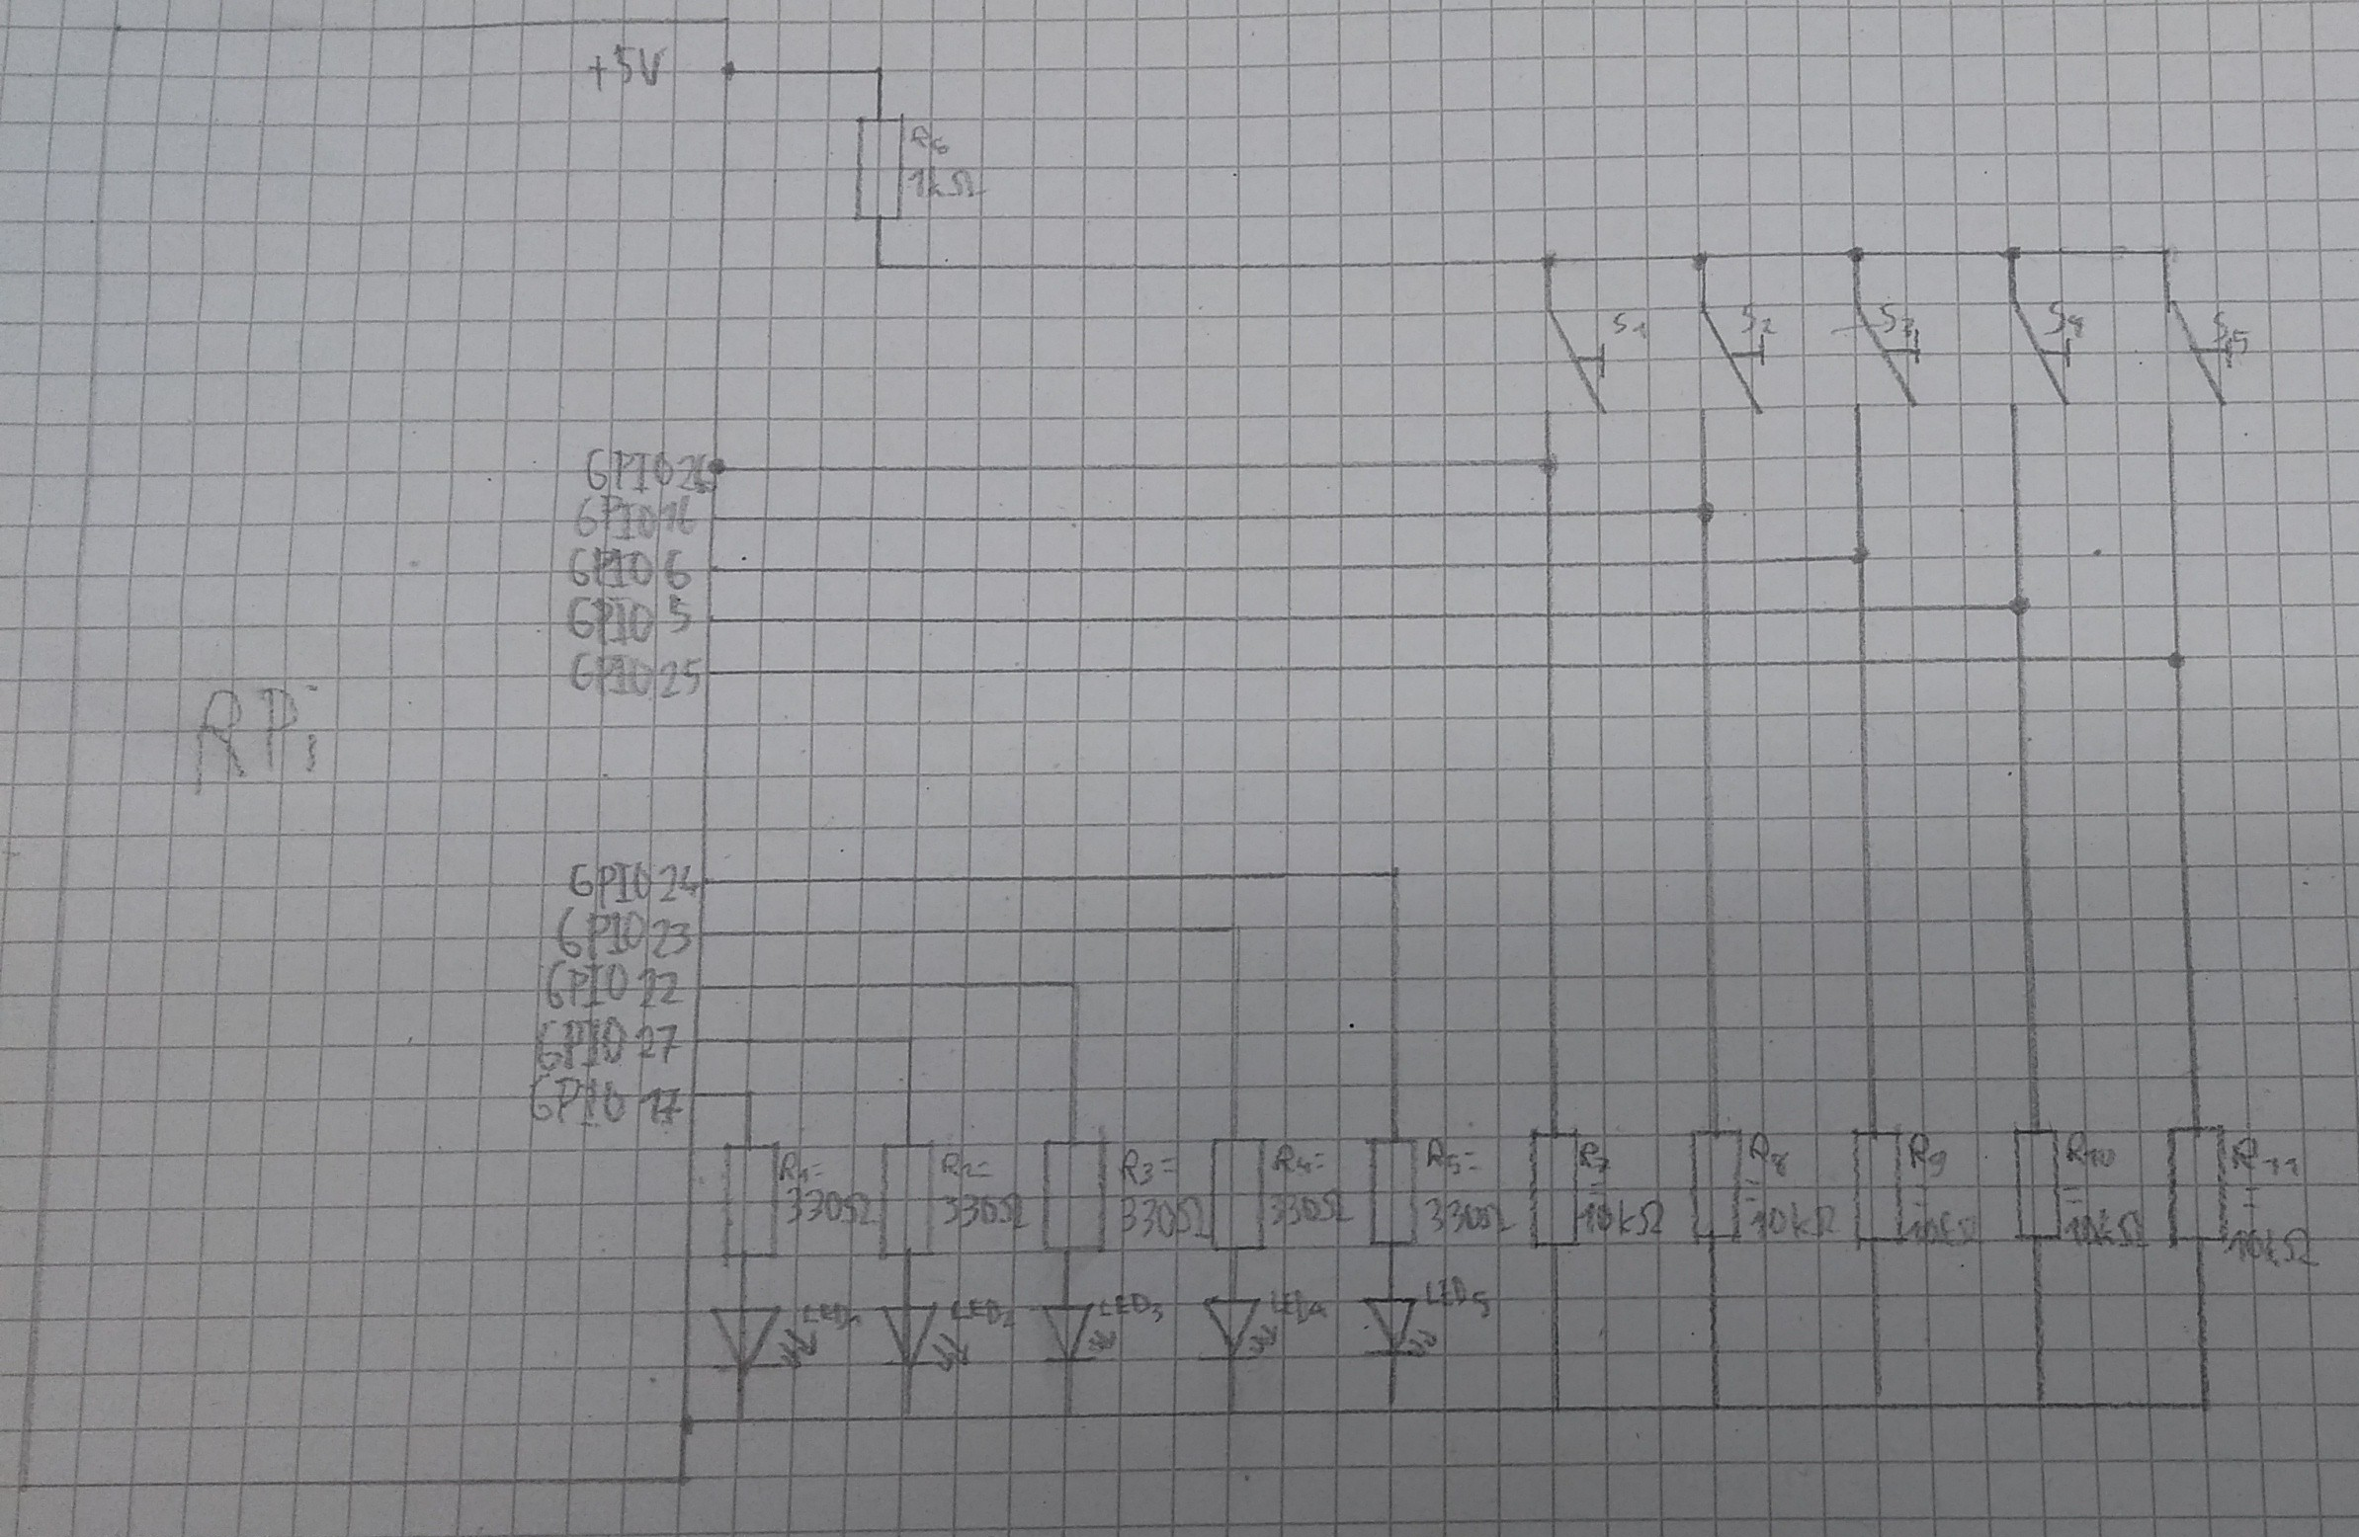

Slide 5
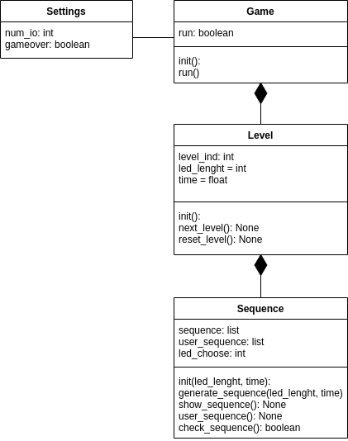
Altes Klassendiagramm
.

Slide 6
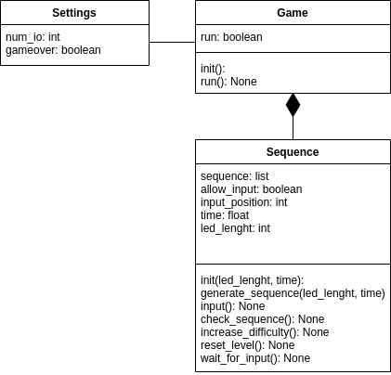
Neues Klassendiagramm

Slide 7
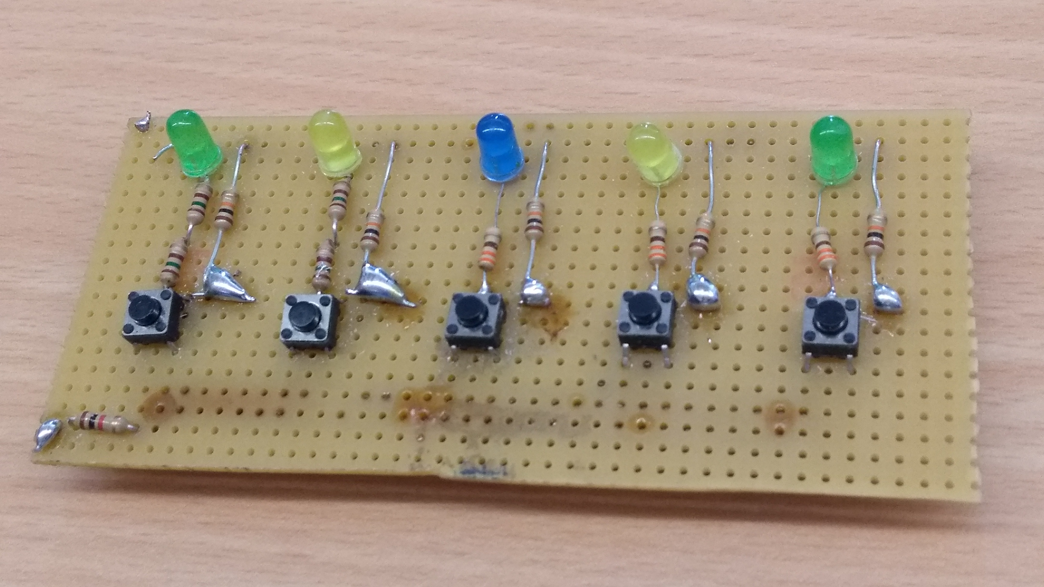
Box
1x Raspberry pi 4
1x Platine
1x 1kΩ
5x 330Ω
5x 10kΩ
5x LEDs
X Jumper wire

Slide 8
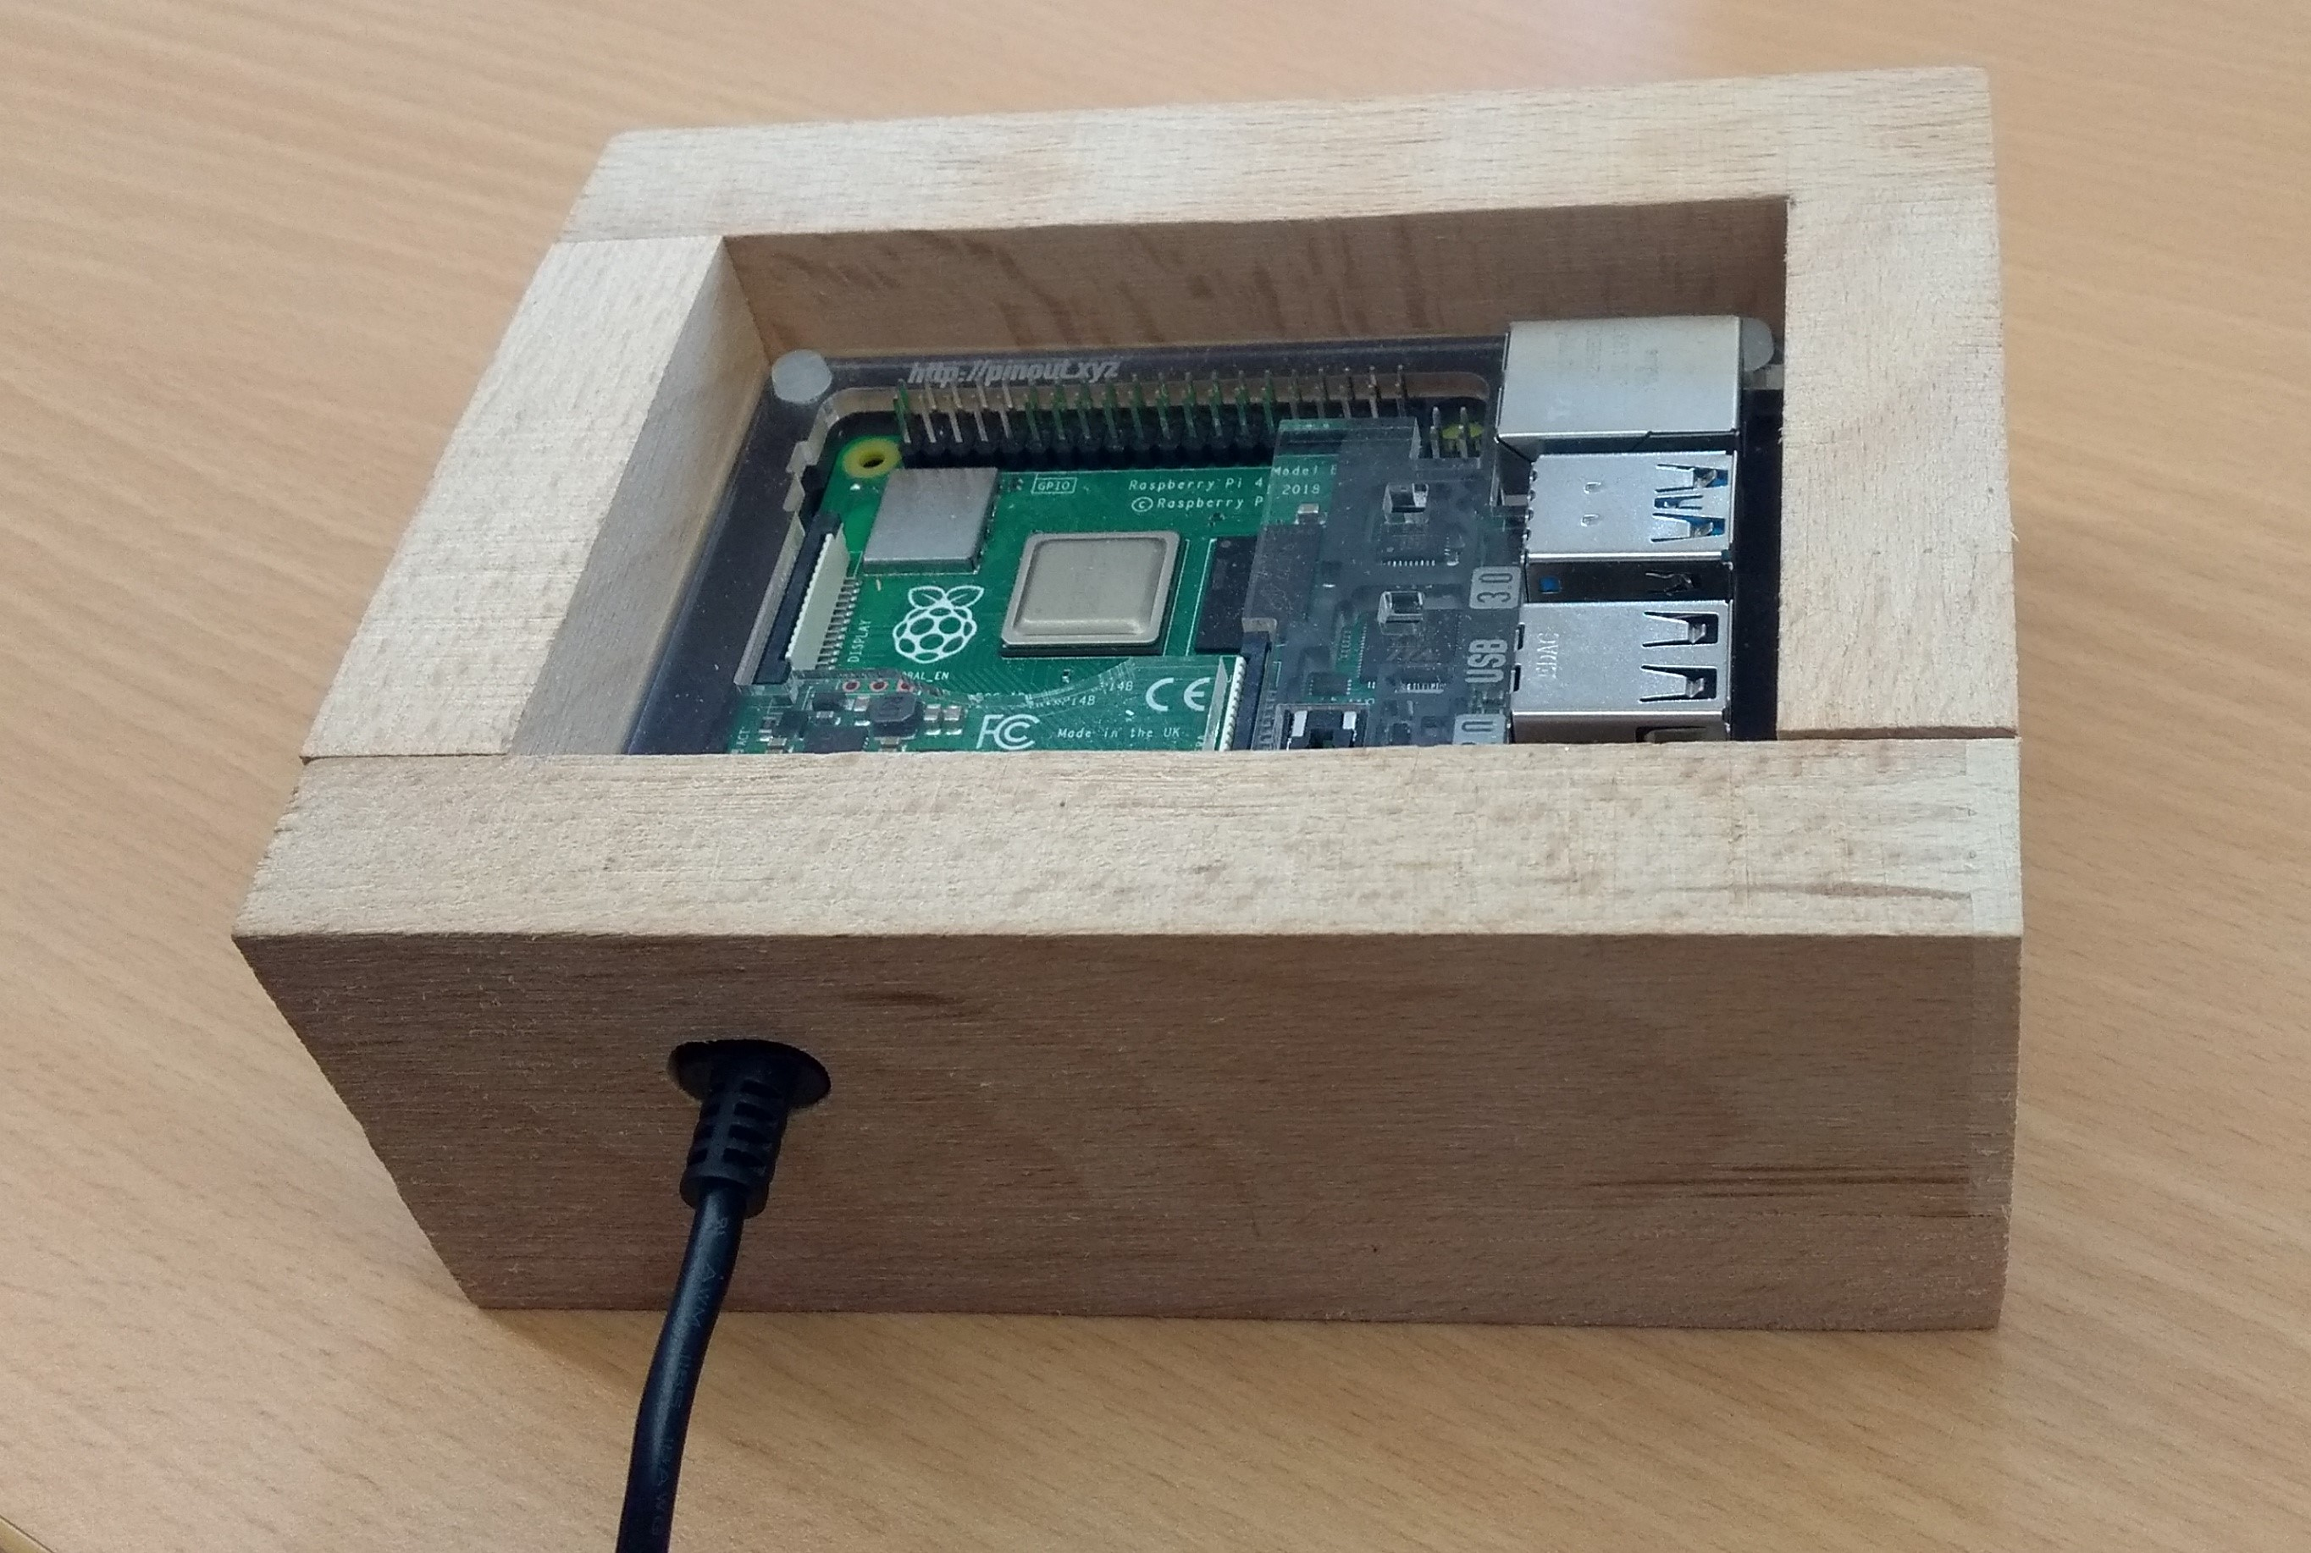
Box

Slide 9
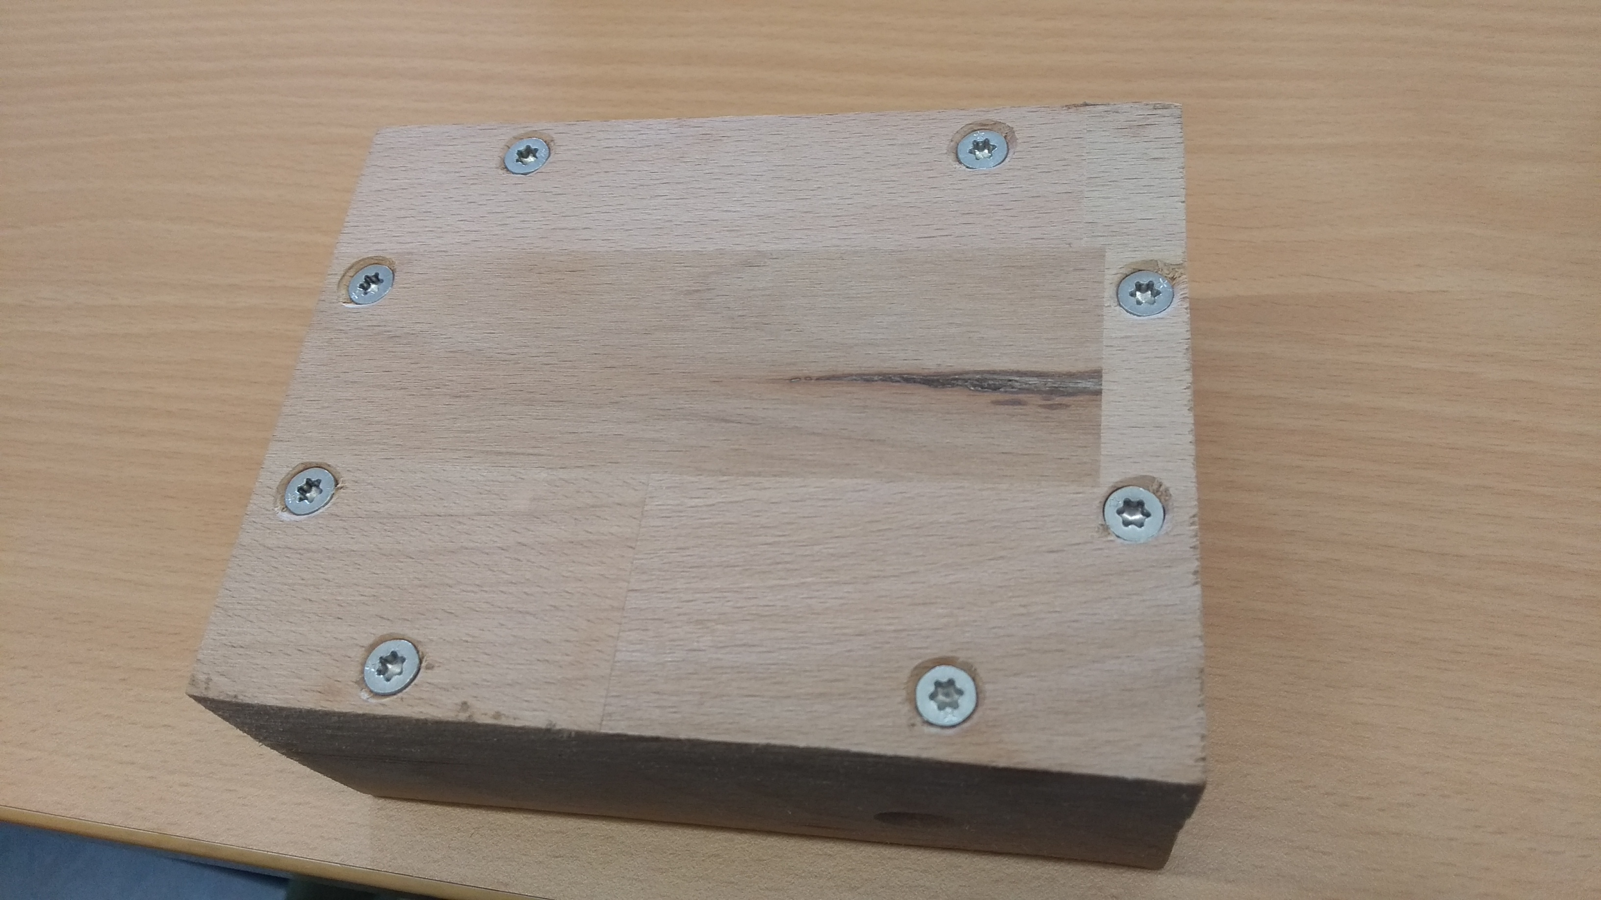
Box

Slide 10
Probleme beim Bauen
Platinen Bauteile
Box Deckel

Slide 11
Code
 | self.sequence.generate_sequence() self.sequence.show_sequence() self.sequence.wait_for_input()
 | Kompletten Main-Funktionen
 | Zeigen wir euch jetzt

Slide 12
Code #1
class Settings():
num_io = 5
led1 = LED(17)
led2 = LED(27)
led3 = LED(22)
led4 = LED(23)
led5 = LED(24)
class Game():
def __init__(self):
self.button1 = Button(25, pull_up=False)
self.button2 = Button(5, pull_up=False)
self.button3 = Button(6, pull_up=False)
self.button4 = Button(16, pull_up=False)
self.button5 = Button(26, pull_up=False)
self.sequence = Sequence()
self.button1.when_pressed = self.sequence.input1
self.button2.when_pressed = self.sequence.input2
self.button3.when_pressed = self.sequence.input3
self.button4.when_pressed = self.sequence.input4
self.button5.when_pressed = self.sequence.input5
self.running = False
def run(self):
self.running = True
while self.running:
self.sequence.generate_sequence()
self.sequence.show_sequence()
self.sequence.wait_for_input()

Slide 13
Code #2
class Sequence():
def __init__(self):
self.sequence = []
self.allow_input = False
self.input_position = 0
self.time = 0.5
self.led_length = 5
def generate_sequence(self):
for i in range(0, self.led_length):
add_s = random.randint(1, Settings.num_io)
self.sequence.append(add_s)
def input1(self):
if self.allow_input == True:
Settings.led1.on()
sleep(0.2)
Settings.led1.off()
self.check_sequence(1)
def show_sequence(self):
for i in self.sequence:
if i == 1:
Settings.led1.on()
sleep(self.time)
Settings.led1.off()
sleep(self.time)

Slide 14
Code #3
def check_sequence(self, button_id):
self.input_position += 1
if self.sequence[self.input_position - 1] == button_id:
print(f"Richtig! {self.input_position}/{self.led_length}")
else:
print("Gameover!")
self.reset_level()
if self.input_position == self.led_length:
self.increase_difficulty()
[LED.Animation, 3 Sek cooldown, print]
self.sequence = []
self.allow_input = False
def increase_difficulty(self):
self.led_length += 1
self.time * 0.8
def wait_for_input(self):
self.input_position = 0
self.allow_input = True
while self.allow_input:
sleep(0.1)
def reset_level(self):
self.led_length = 5
self.time = 0.5
Settings.led1.on()
Settings.led2.on()
Settings.led3.on()
Settings.led4.on()
Settings.led5.on()
[LED.Animation, 3 Sek cooldown, print]
self.sequence = []
self.allow_input = False

Slide 15
Probleme beim Coden
Playerinput
(not solved) Listen haben sich gewiped
Funktion anders erstellt

Slide 16
Live-Presentation
Genießt die Show

Slide 17
Vielen Dank für Ihre Aufmerksamkeit
Fragerunde
Link zum GIT

